Slide 1


Progress Report : February 22nd, 2011
Brett Baumert, Curtis Johnson, Mike Kelly
Notes:
Brett

Slide 2
Overview
Project Review & Previous Work
Our Competitors
Project Progress
OBDme Demo
What’s to come
Notes:
Brett

Slide 3
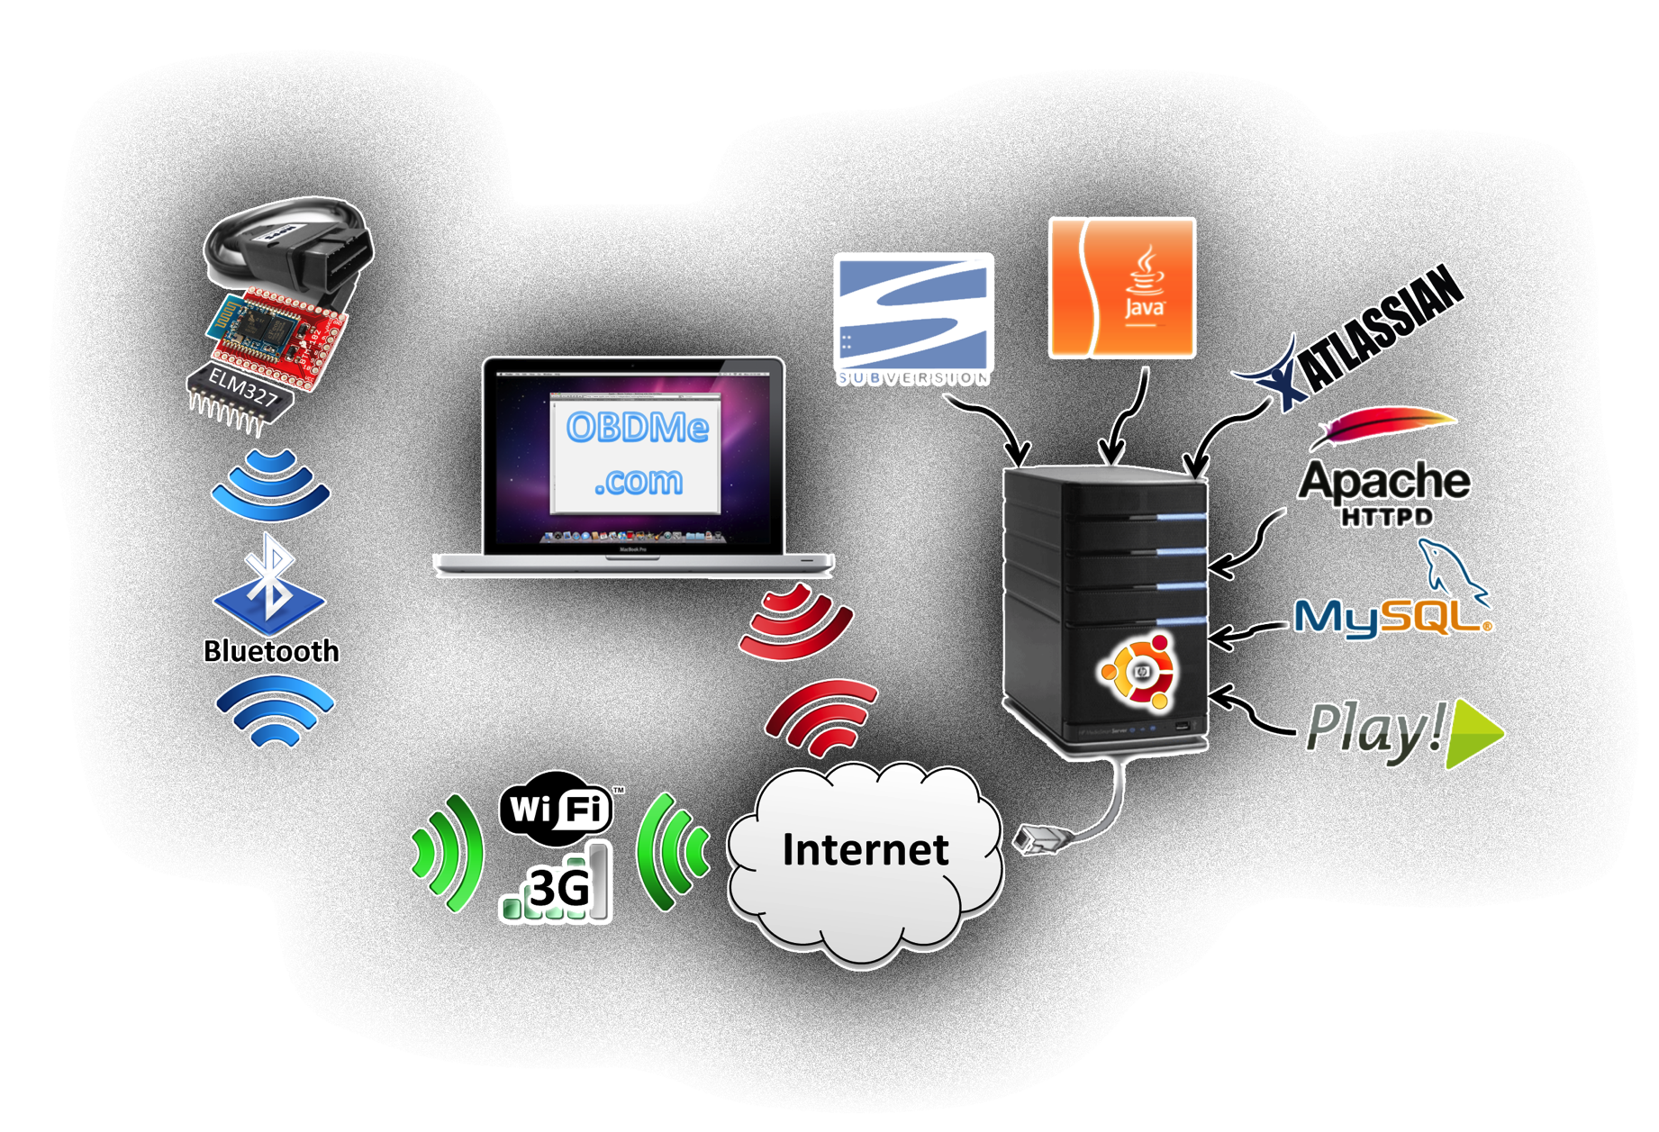
OBDme Architecture
Notes:
Curtis

Slide 4
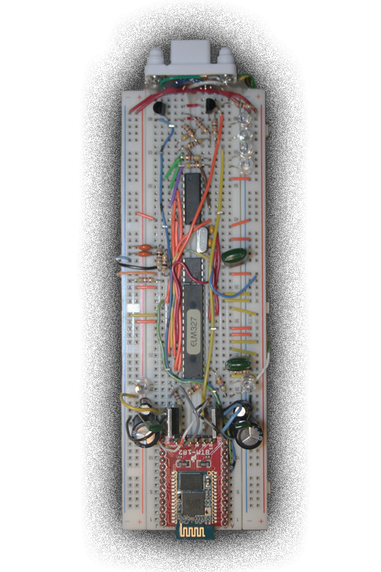
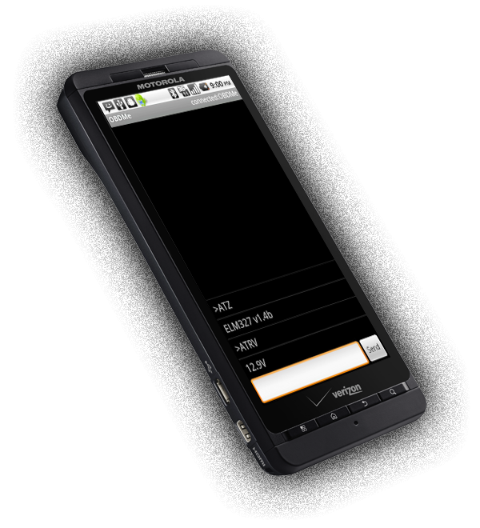

Previous Work: Mini Project
Hardware Implementation
Interface with OBD-II
Bluetooth Communication
Software
“Hardware Terminal”
Primitive Android App
Server (Frank)
Atlassian Tools
OBDme.com
Notes:
Mike

Slide 5
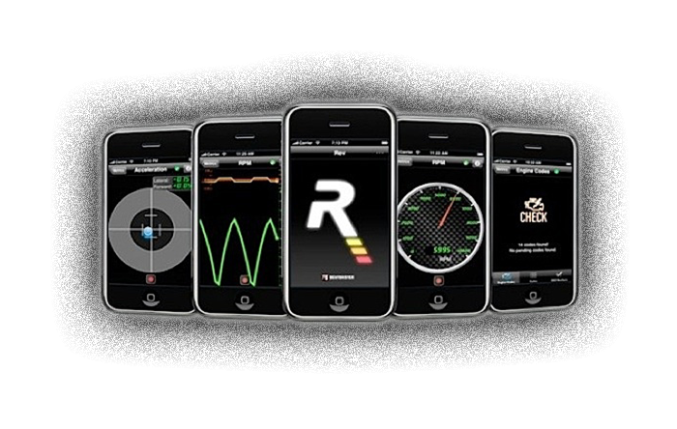

Our Competitors
Android
Torque
iPhone
Rev
OBD-II Bluetooth Transceivers
Scantool.net
OBDKey
Notes:
Brett

Slide 6
Our Competitors
What separates us from the rest?
Data Collection
Persistent
Single Source
Android Application
Minimalistic Design
Easy to see (High Contrast)
Web Application
Automated statistics
Trends
Notes:
Brett

Slide 7

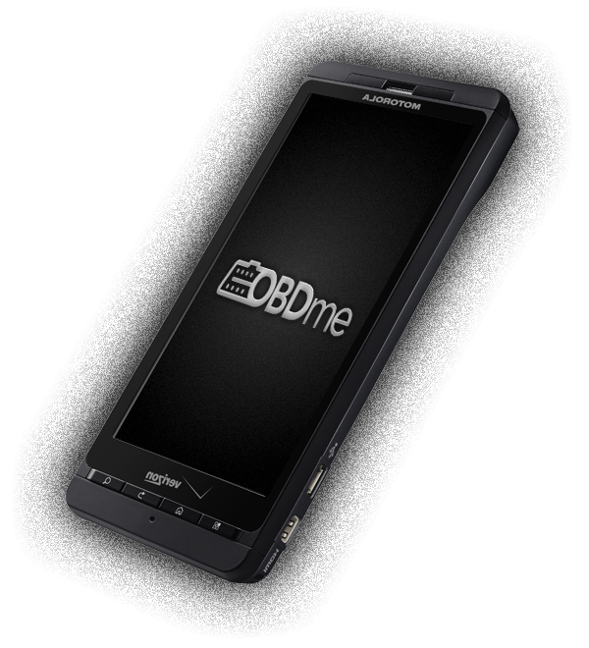
Android Application
Setup Wizard
User Registration
Vehicle Registration
Intuitive
Basic UI
Displays Live OBD Data
Preferences
Data Logging
Temporary – Data to Phone SQLite
Persistent Storage
Notes:
Mike

Slide 8

REST API Framework
Purpose
Validating Users
Registering Vehicles
Data Persistence and Logging
Features
Built on Play! Framework
Initial Security Implemented
Examples
GET http://obdme.com/api/users/cjohnson@cse.unl.edu
PUT http://obdme.com/api/vehicles
Notes:
Curtis

Slide 9
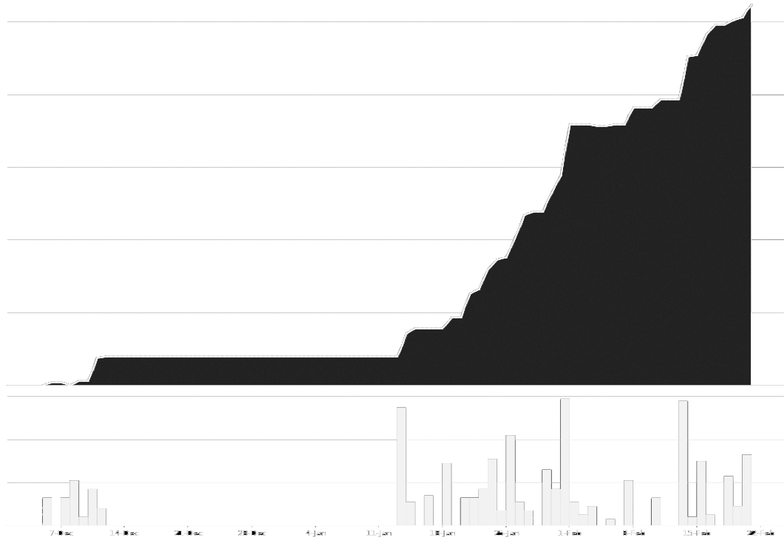
Development Metrics
15K
12K
9K
6K
3K
7-Dec
22-Feb
Notes:
Mike

Slide 10
Demo
Notes:
Mike

Slide 11

What’s to Come: Android
UI Modes (Basic, Advanced, Graphing)
Efficiency
OBD Error Codes
Trip Feature
Notes:
Brett

Slide 12
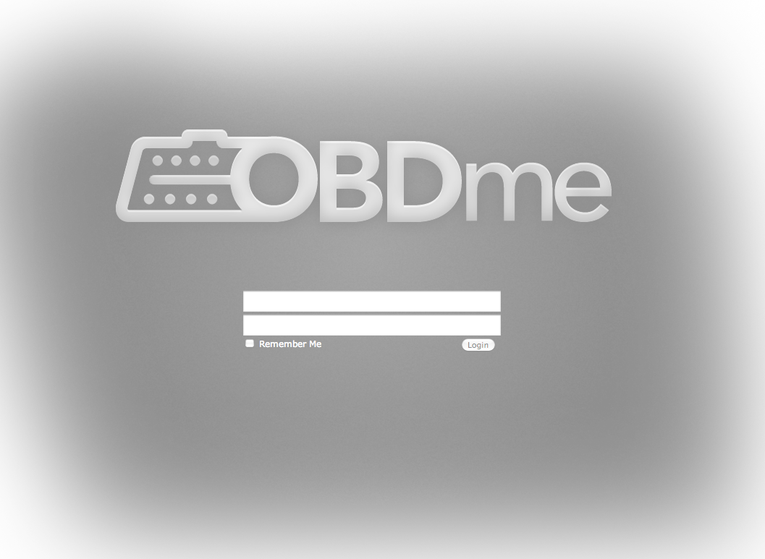
What’s to Come: Web and API
Web App User Interface
Data Graphing & Analysis
Trips & Maps
Notes:
Curtis

Slide 13
Schedule
Finalize Testing of Applications (Android and Web)
Server-Side Implementation of Learning Algorithms (time permitting)
Web App Nearing Completion
April 30, 2011
March 31, 2011
February 28, 2011
Continuing Android Development
REST API Features (GPS, Trips)
Android App Nearing Completion
E-Week Preparation
Notes:
Curtis

Slide 14
Questions?
Notes:
Mike

